Slide 1
Course summary

Slide 2
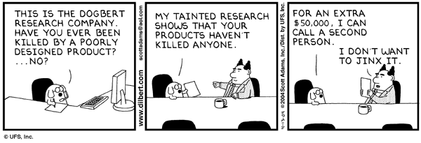
Data collection
Random sample
Random assignment
Case-control
Observational
Sample bias
Survivorship bias

Slide 3

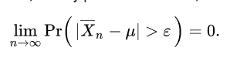
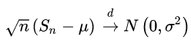
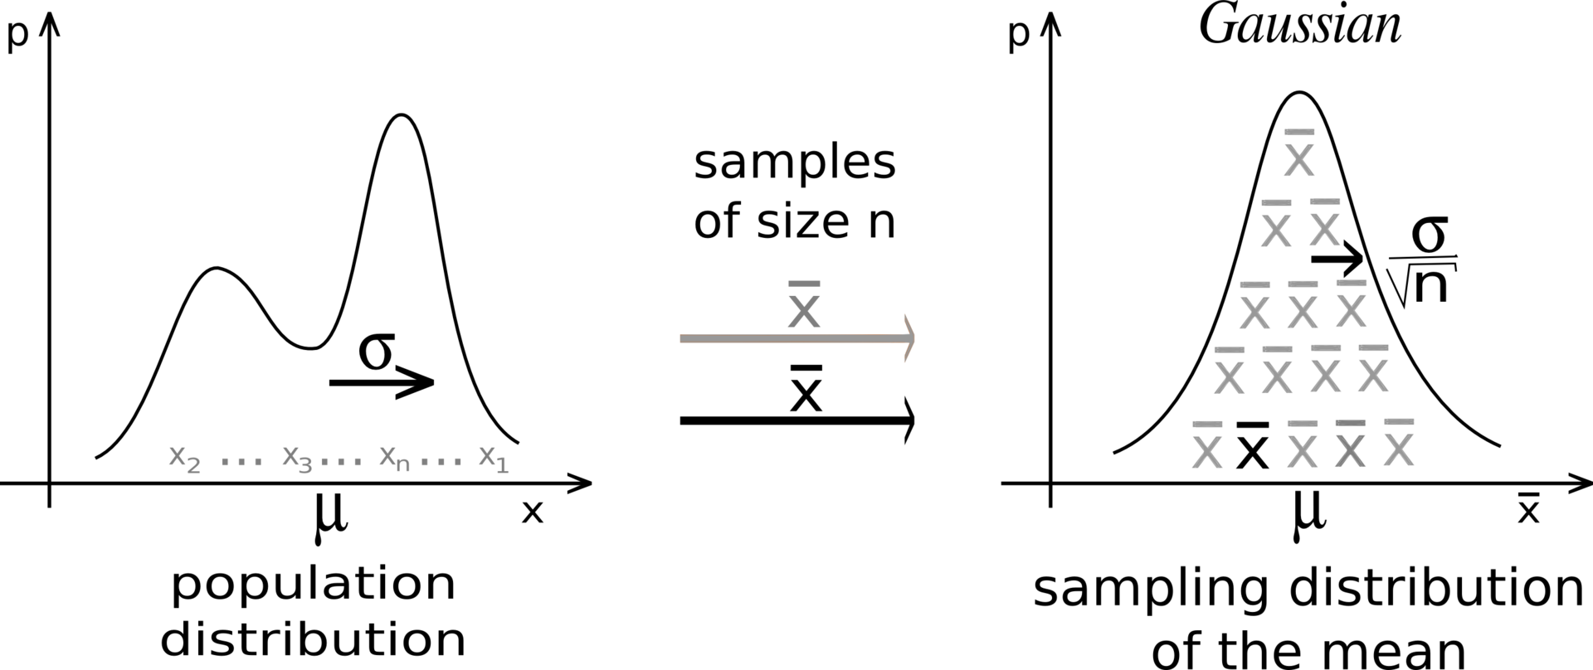

Stat basics
Law of large numbers
Central limit theorem

Slide 4
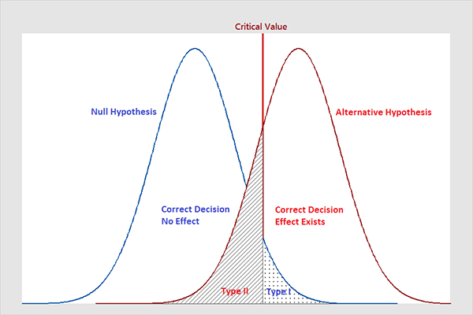
Stat basics 2
Hypothesis testing
Type 1 error
Type 2 error
Power
Effect size
Analytical solution
simulation

Slide 5
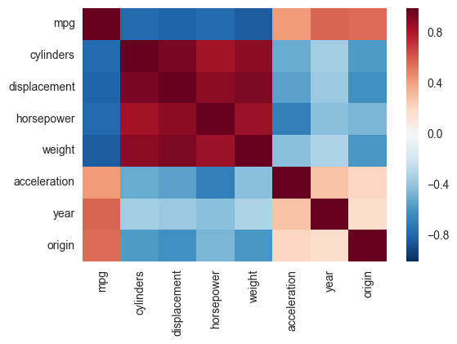
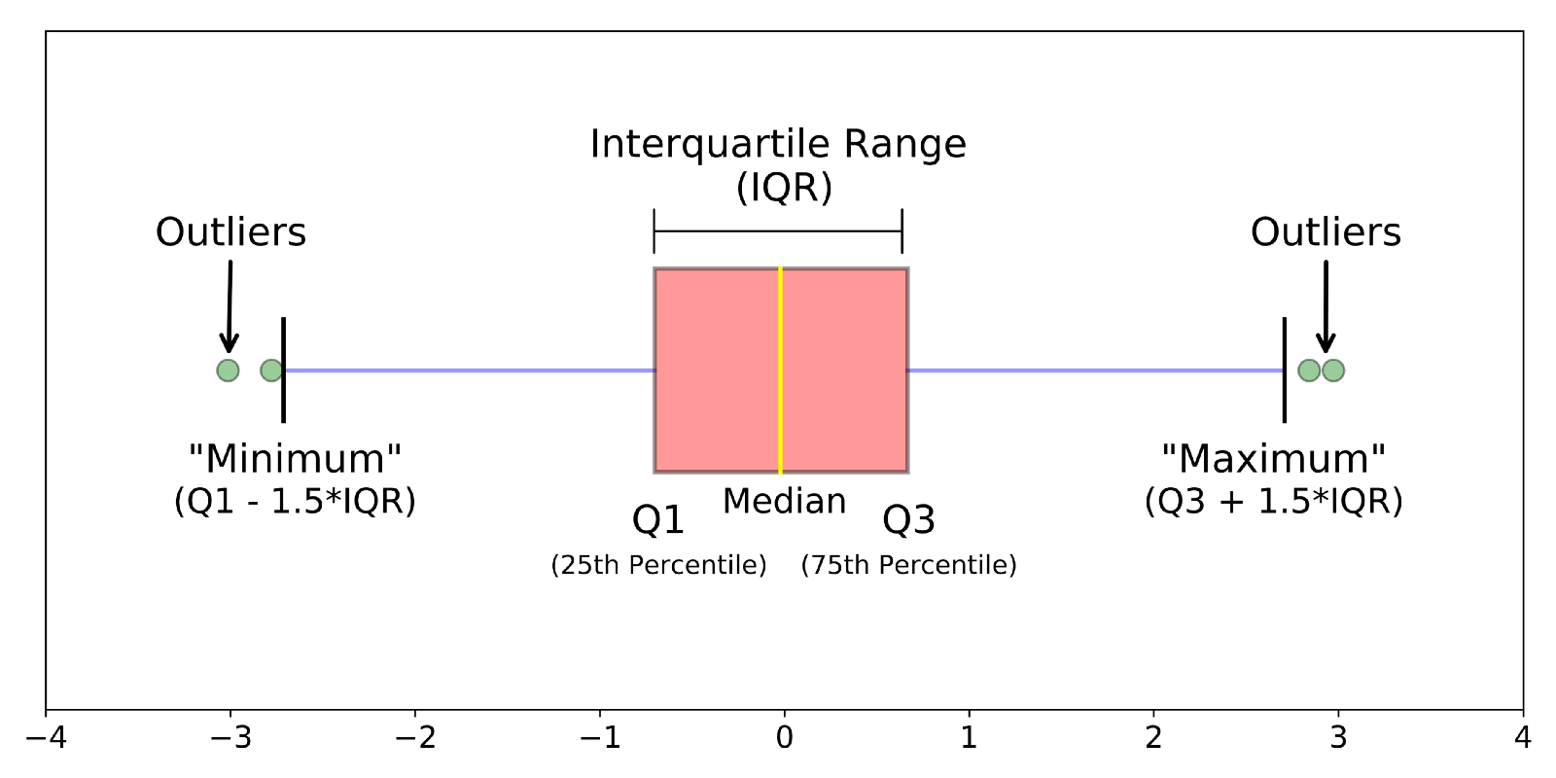
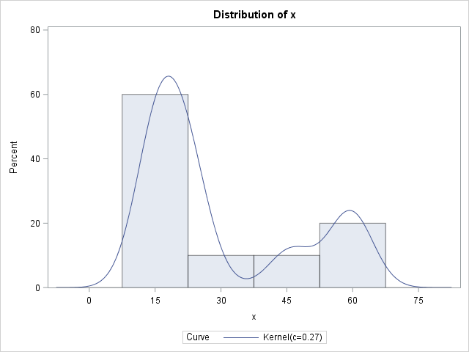
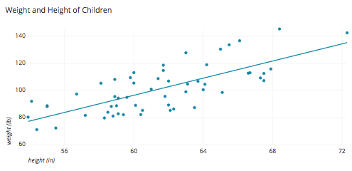
Exploratory data analysis
Look at the distribution
Histogram
Kernel density estimation
Boxplot / swarmplot
Look at the Joint distribution
scatter plot
Heatmap (of correlations)

Slide 6
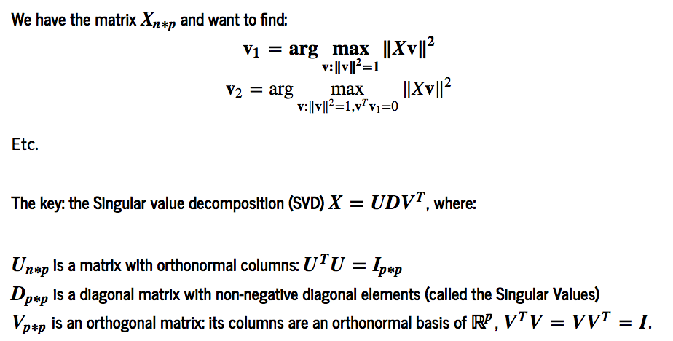
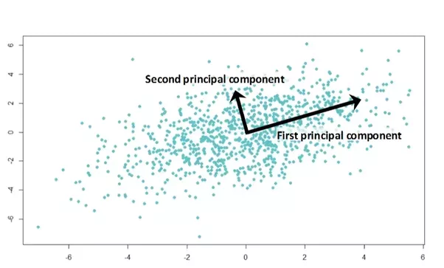
Dimensionality reduction
PCA
SVD

Slide 7
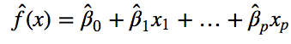
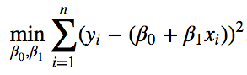
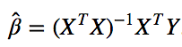
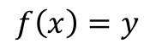
Predictive modeling (classic)
True relationship
$$f\left(x\right)=y$$
Assume linearity
Linear regression
What if we want non-linear relationship?
What if we use a different “loss” function?
What if y is bounded?
What if we are interested in f() itself?
Minimize RSS
Linear algebra solution

Slide 8
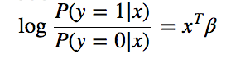
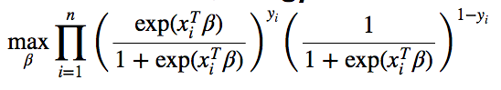
Predictive modeling (classic)
for classification we model the log-odds ratio as a linear function of x
logistic regression
What if we want non-linear relationship?
What if we are interested in f() itself?
we formalize the maximization problem using maximum likelehood
This is a private case of ”generalized linear models”, using the logit as the “link function”

Slide 9
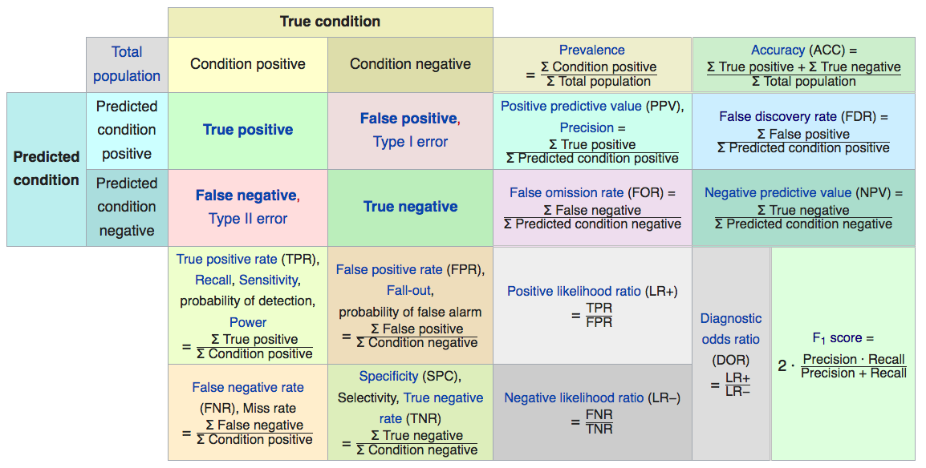

Classification metrics

Slide 10
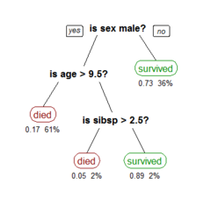
Tree models
CART
Surrogate splits
High flexability

Slide 11
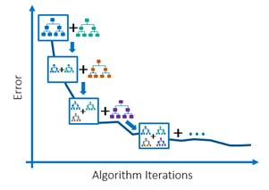
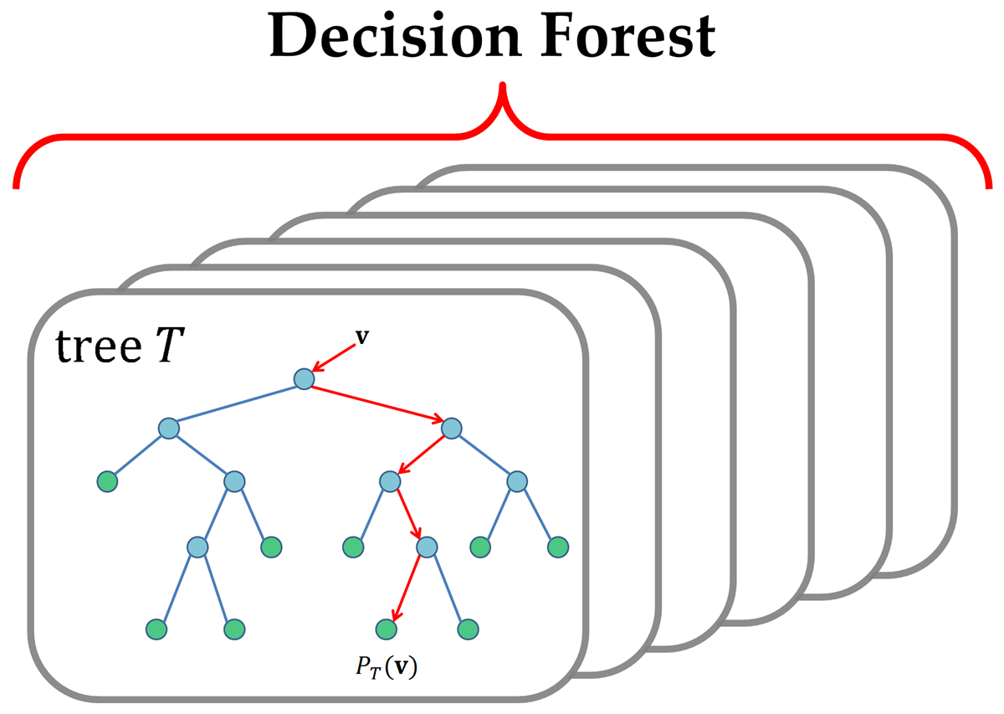
Ensamble models (usually trees)
Bagging
boosting

Slide 12

Deep learning
Fully connected (multi level perceptron)
What parameters to learn
What hyper parameters to tune
Regularization
dropout

Slide 13

Deep learning
Convolutional neural network
Whats new?
Why does this work?
Regularization
Pooling

Slide 14
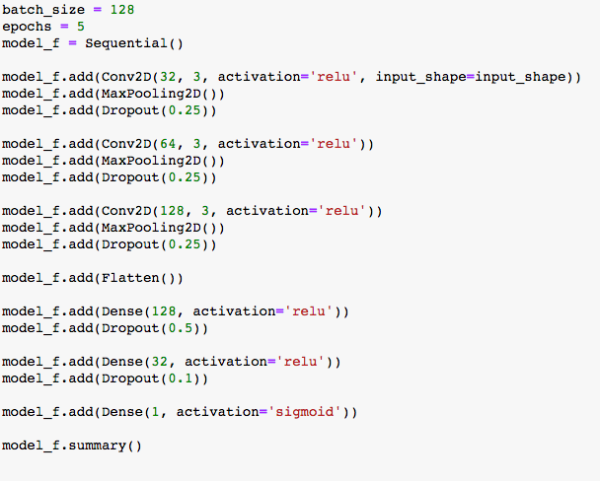
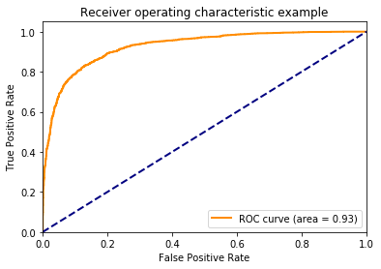

Case study
Convolutional neural network
Why?
AUC = 0.93
Accuracy = 85%
Why can’t we get 100%?!?

Slide 15
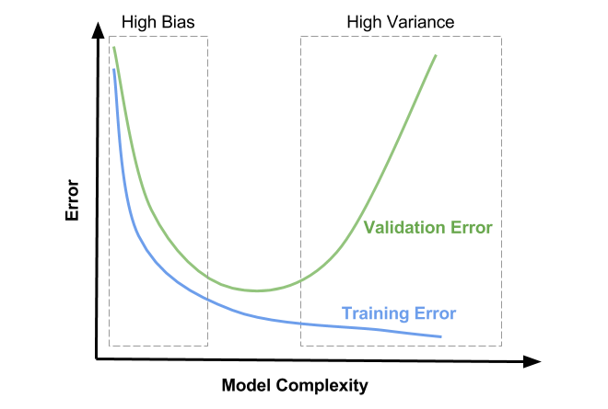
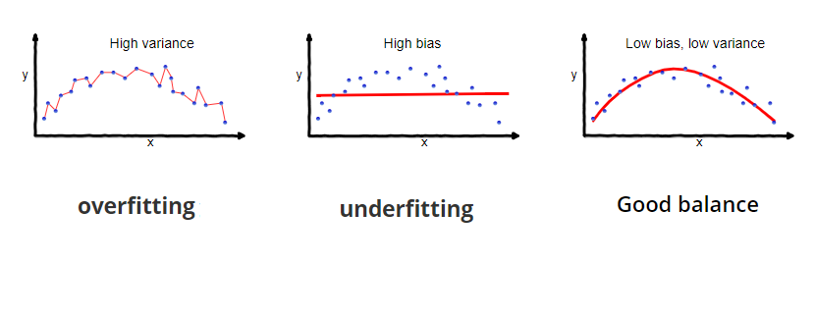
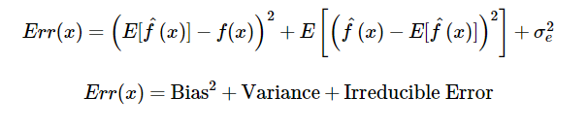
Bias variance tradeoff

Slide 16
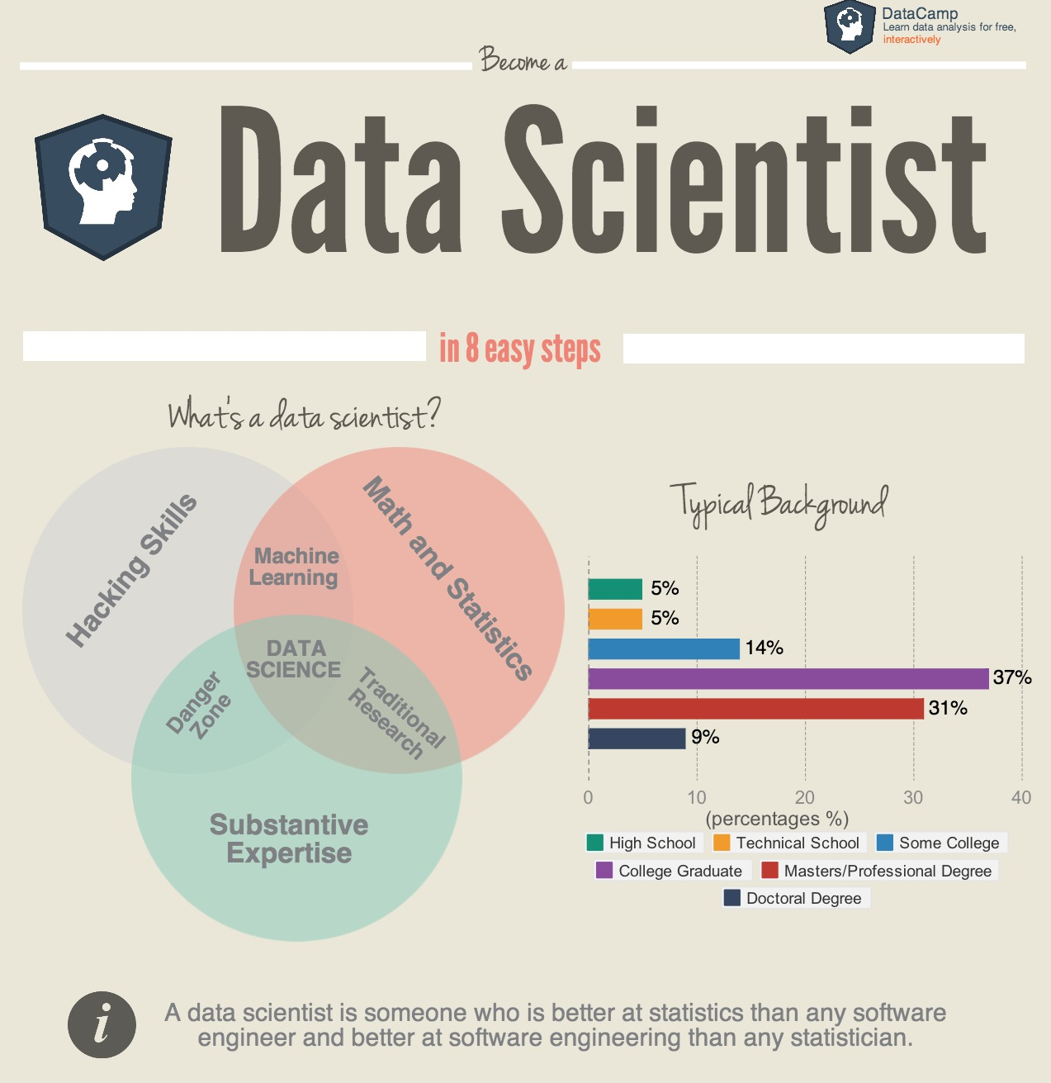
Can we automate data science?
Yes – some parts
Understanding of domain problem
Ability to model the solution
What data do we need?
How much is enough?
How to avoid data pitfalls?

Slide 17

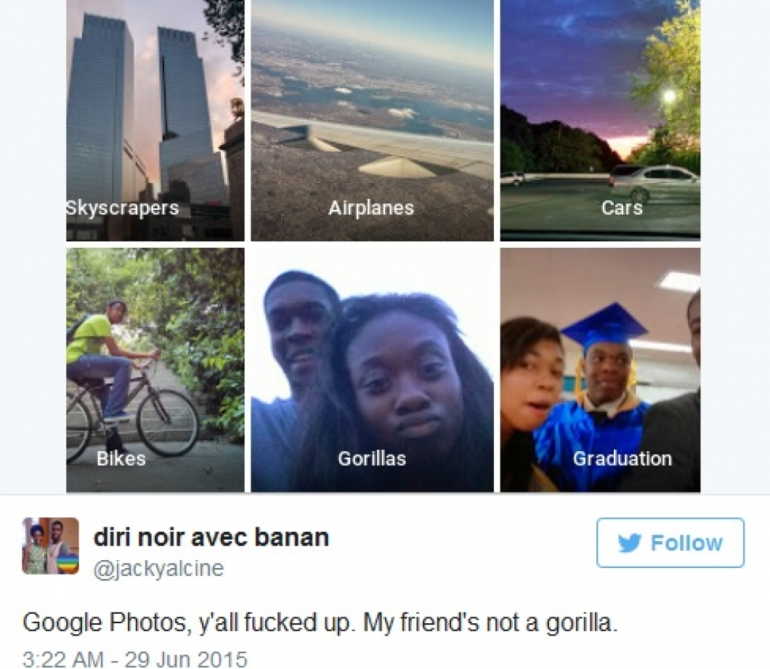
Google photos racist algorithm
link

Slide 18
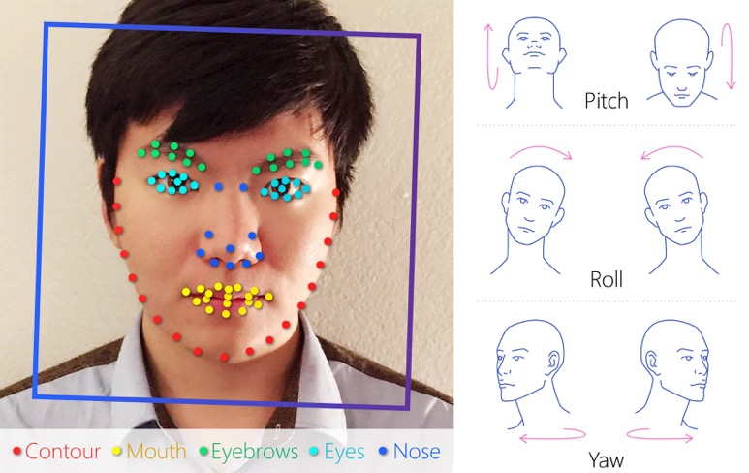
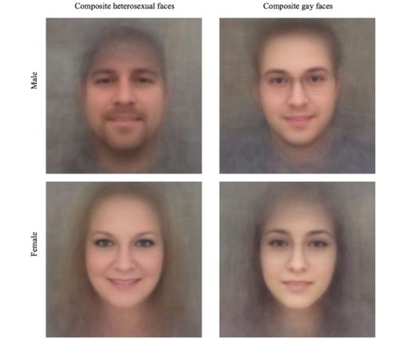
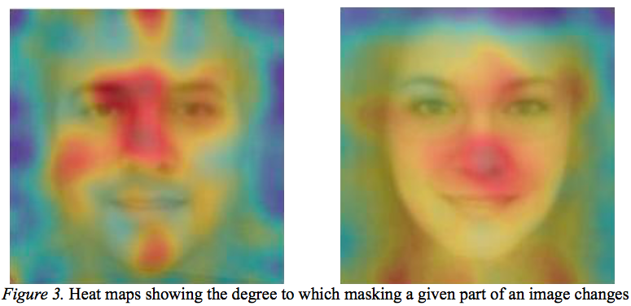
Stanford gaydar
A study by Stanford (!)
a neural net can identify sexual orientation.
profile pictures from online dating services. (~4,000 users per sex)
AUC 0.81 for men
AUC 0.71 for women
Human judgement AUC 0.61 for men, 0.52 for women

Slide 19
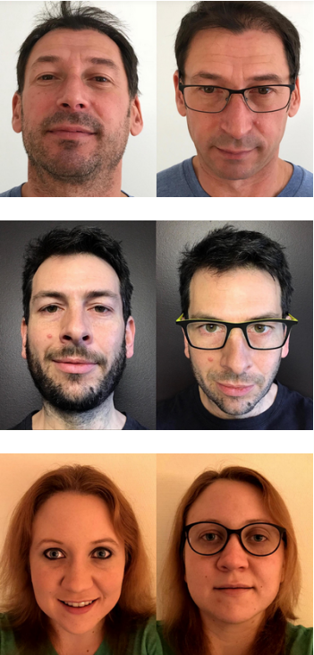
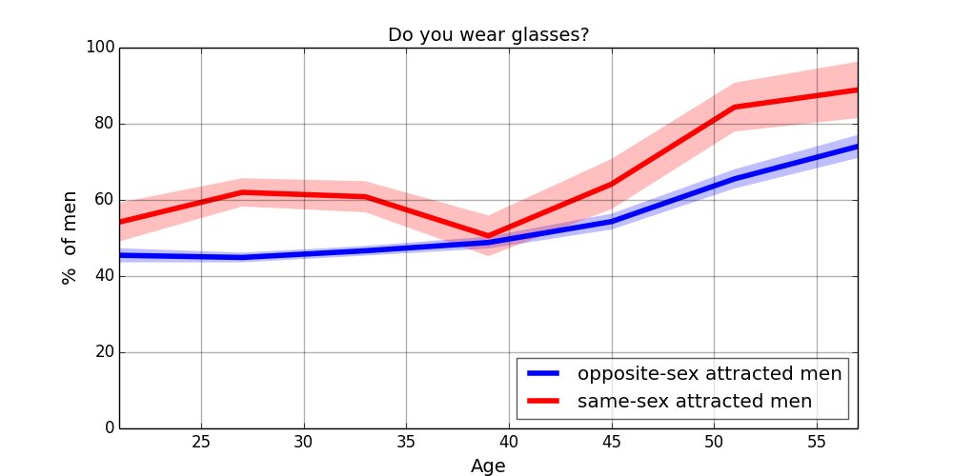
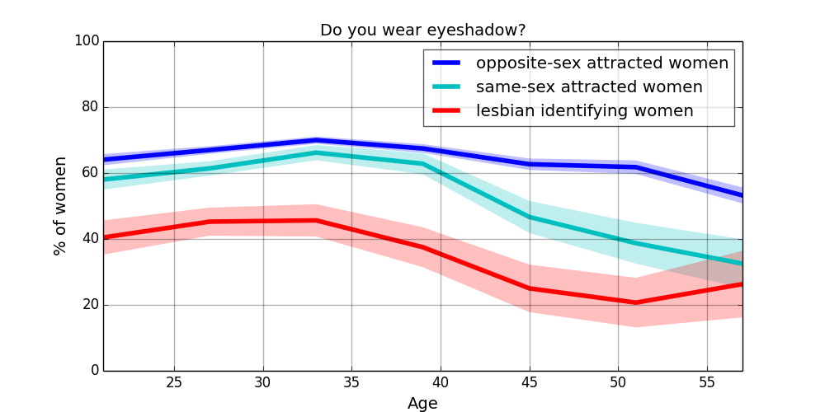
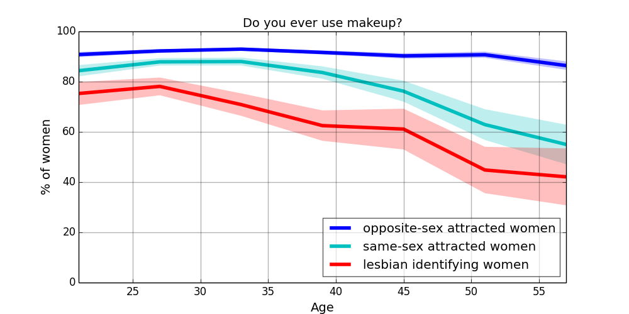
Stanford gaydar
Study criticized by independent researchers

Slide 20

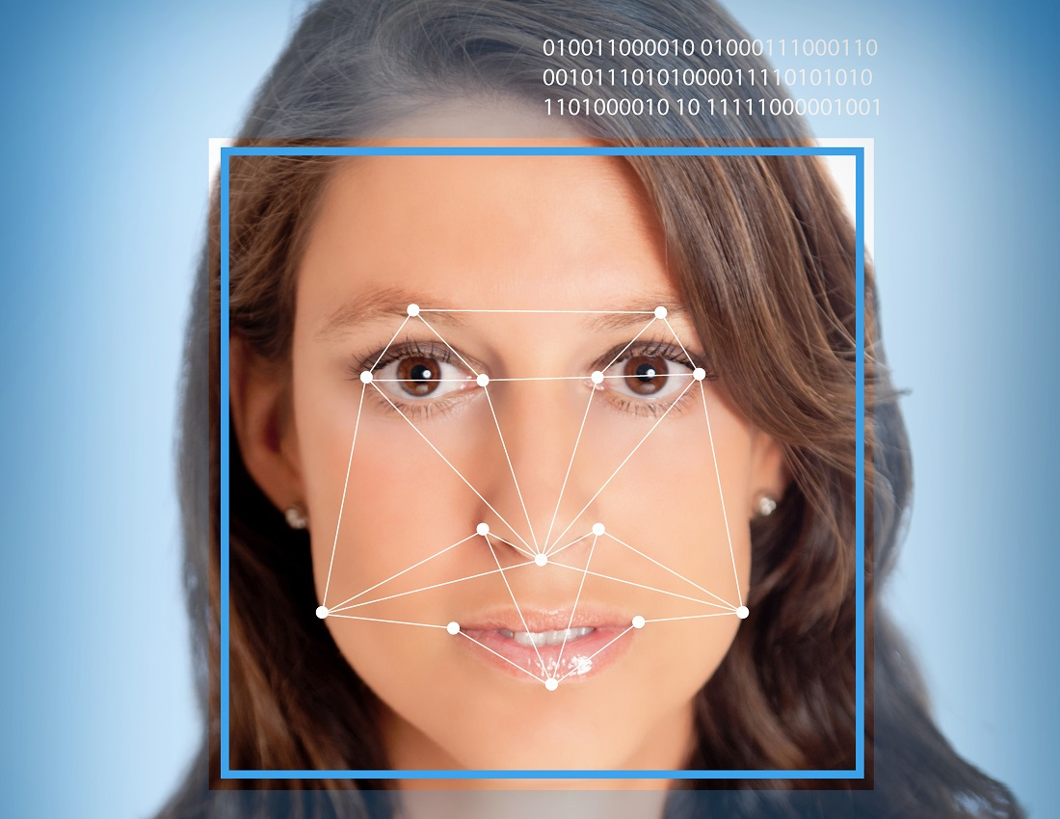
faception
Identify terrorists via face analysis (not facial recognition)
Identified correctly some of the paris 2015 terrorist group

Slide 21
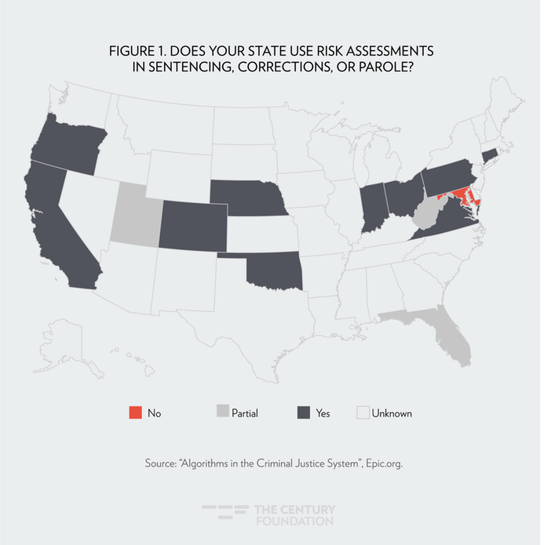
Algorithms in the judicial system
Deciding on probation
Perpetuating bias

Slide 22
further learning
Blogs
Towards data-science
מדעןתונים
FB
Machine and deep learning Israel
עליית המכונות
ממים של דאטה
Meetups
Pydata
Datahack
האיגוד הישראלי לסטטיסטיקה
Podcasts
Data stories
Linear digressions
Partially derivative ☹
Unsupervised
Oriely data show
Not so standard deviations
Twiml ai
Talking machines
Data skeptic

